Slide 1

Geometry
Unit 5, Lesson 3 Exploring Angle-Angle-Side and Hypotenuse-Leg Triangle Congruence Volume 1, pg. 234

Slide 2


Benchmarks
MA.912.GR.1.2
Prove triangle congruence or similarity using Side-Side-Side, Side-Angle-Side, Angle-Side-Angle, Angle-Angle-Side, Angle-Angle, and Hypotenuse-Leg.
MA.912.GR.5.1
Construct a copy of a segment or an angle.
volume 1, pg. 234

Slide 3
Integrated Mathematical Thinking and Reasoning Standards
MA.K12.MTR.1.1 Actively participate in effortful learning both individually and collectively.
MA.K12.MTR.4.1 Engage in discussions that reflect on the mathematical thinking of self and others.
volume 1, pg. 234

Slide 4

Learning Targets
I can use constructions to determine if AAS congruence can be used to show that two triangles are congruent.
I can determine if HL congruence can be used to show that two triangles are congruent using deduction.
volume 1, pg. 234

Slide 5

Warm-Up
volume 1, pg. 234

Slide 6

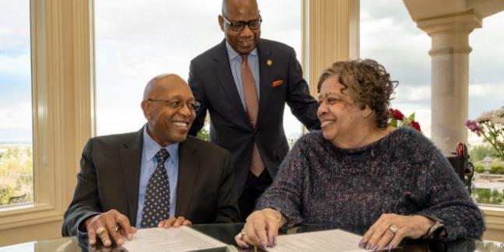
5.3.1 Warm-Up: Giving Back
Morgan State University is a historically black, public research university in Baltimore, Maryland. In the early 1960s, Calvin E. Tyler Jr., a young African American man who was the first in his family to go to college, attended Morgan State. However, in 1963 he was forced to drop out when he was unable to pay his tuition.
volume 1, pg. 234

Slide 7
He began working as a truck driver for the United Parcel Service (UPS). Throughout his career at UPS, he continued to be promoted and ultimately served as both the senior vice president for U.S. operations and as a director within the company. On February 23, 2021, he and his wife Tina pledged $20 million to Morgan State University’s endowment to go toward scholarships for students in financial need.
Choose one of the following questions to answer.
How do you think having a growth mindset likely played a role in Mr. Tyler’s career?
Why do you think it was important to Mr. Tyler to pledge this endowment?
volume 1, pg. 234

Slide 8

Exploration
volume 1, pg. 235

Slide 9

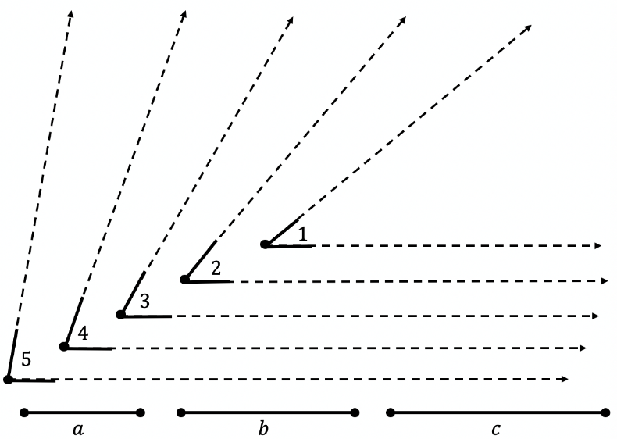
5.3.2 Exploration: Which Other Criteria Is Enough?
Five angles labeled 1-5 and three line segments labeled $a, b,$ and $c$ are given.
Use the given parts to create triangles by copying the parts needed onto patty paper using the given criteria.
Helpful Hint: When copying an angle, include some (or all) of the dotted lines so that angles and line segments can be connected.
volume 1, pg. 235

Slide 10
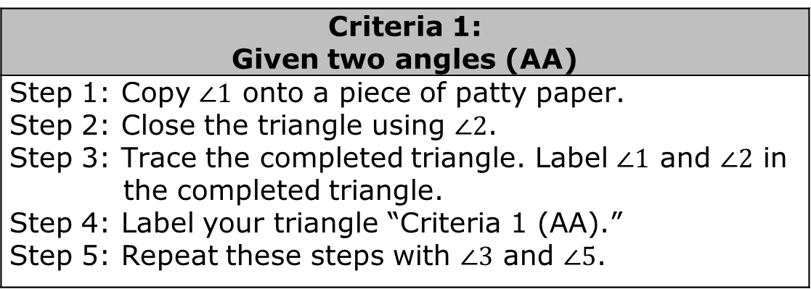
Construct two different triangles using each set of criteria. Use the provided steps in each criteria.
Criteria 1: Given two angles (AA)
Step 1: Copy $∠1$ onto a piece of patty paper. Step 2: Close the triangle using $∠2$. Step 3: Trace the completed triangle. Label $∠1$ and $∠2$ in the completed triangle. Step 4: Label your triangle “Criteria 1 (AA).” Step 5: Repeat these steps with $∠3$ and $∠5$.
volume 1, pg. 235

Slide 11
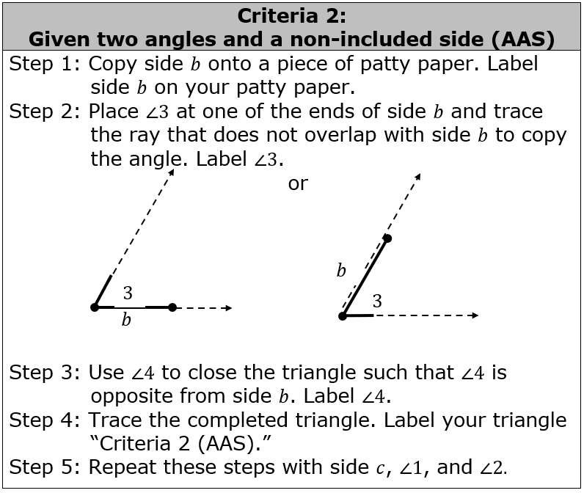
volume 1, pg. 236

Slide 12
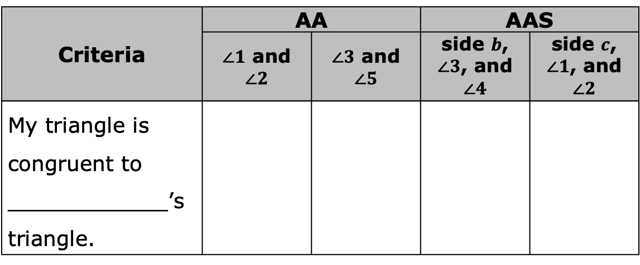
Compare your four triangles with your partner’s.
Write your partner’s name on the line in the table. Then, state “true” or “false” to indicate if your triangle is congruent to your partner’s triangle for each criteria.
Criteria | AA |  | AAS
 | $∠1$ and $∠2$ | $∠3$ and $∠5$ | side $b$, $∠3$, and $∠4$ | side $c$, $∠1$, and $∠2$
My triangle is congruent to ____________’s triangle.
volume 1, pg. 236

Slide 13
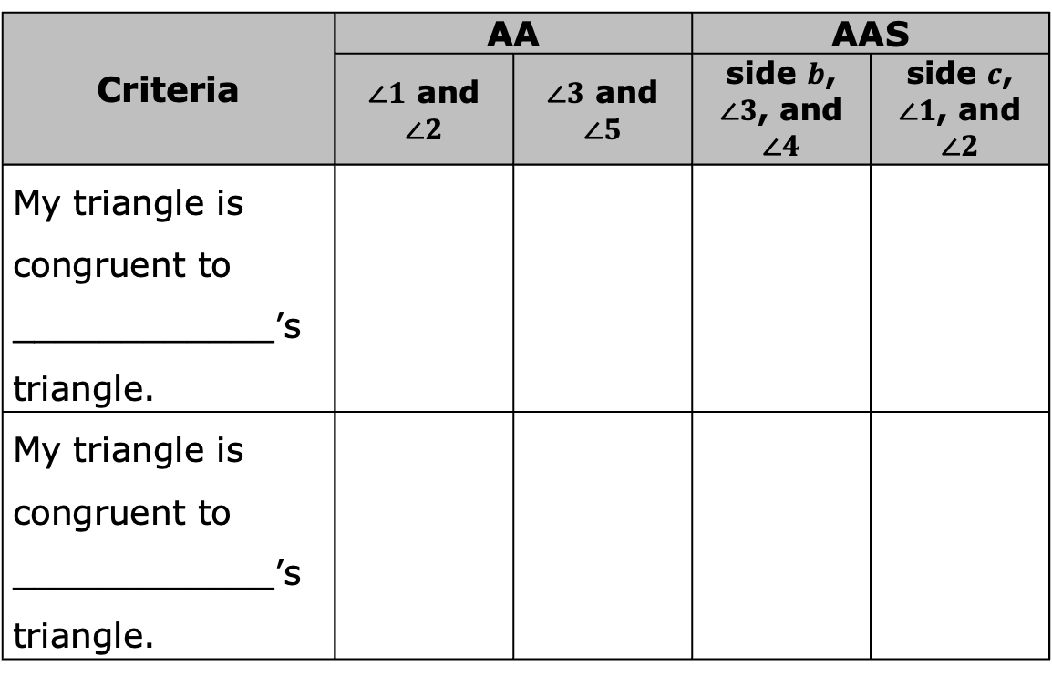
With your partner, find another pair of students to form a group of four. Write the two new students’ names in the table below. Then, state “true” or “false” to indicate if your triangle is congruent to your partner’s triangle for each criteria.
Criteria | AA |  | AAS
 | $∠1$ and $∠2$ | $∠3$ and $∠5$ | side $b$, $∠3$, and $∠4$ | side $c$, $∠1$, and $∠2$
My triangle is congruent to ____________’s triangle.
My triangle is congruent to ____________’s triangle.
volume 1, pg. 236

Slide 14
Discuss with your group: If given either set of criteria, does that mean all of the parts of the triangles are congruent? Then, write your explanation in the table.
Criteria | Explanation
Given two angles (AA)
Given two angles and non-included side (AAS)
volume 1, pg. 237

Slide 15

Collaboration
volume 1, pg. 237

Slide 16

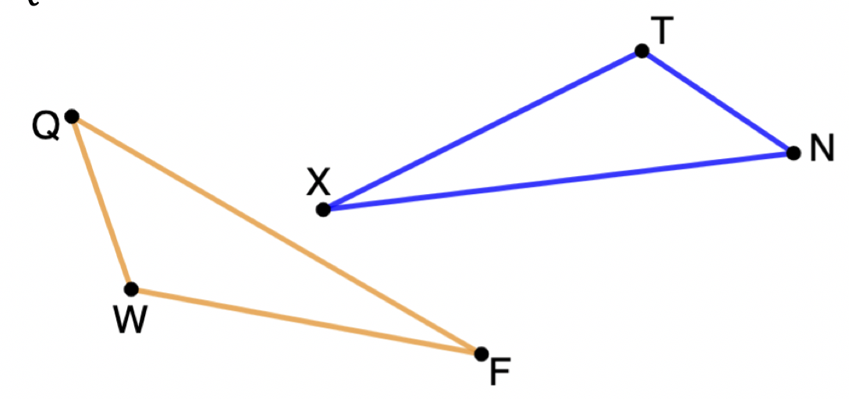
5.3.3 Collaboration: Making Connections
$∆QWF$ and $∆NTX$ are shown. $\overline{FQ}≅\overline{XN}$, $∠FQW≅∠XNT$, and $∠QWF≅∠NTX$.
volume 1, pg. 237

Slide 17
Two students discussed the information given.
Mabel thinks there is not enough information to determine congruence, because the side given is not between the two angles given. | Xavier thinks the triangles are congruent because he knows that the third angles in the triangles have to be congruent, and then there would be a side between two angles.
With your partner, discuss both students’ reasoning. Then, answer the following.
Explain whether you agree with Mabel or Xavier.
What additional information could be added to the argument you agree with to make it more convincing?
volume 1, pg. 237/238

Slide 18
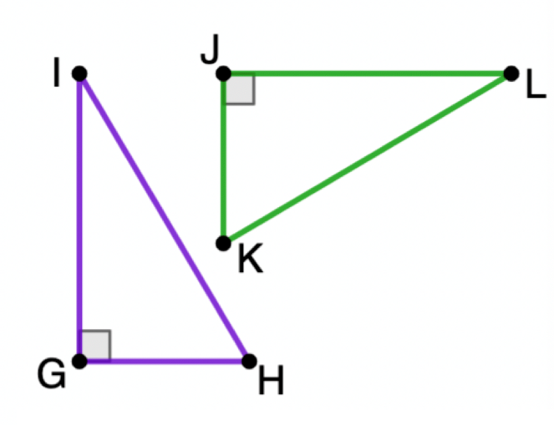
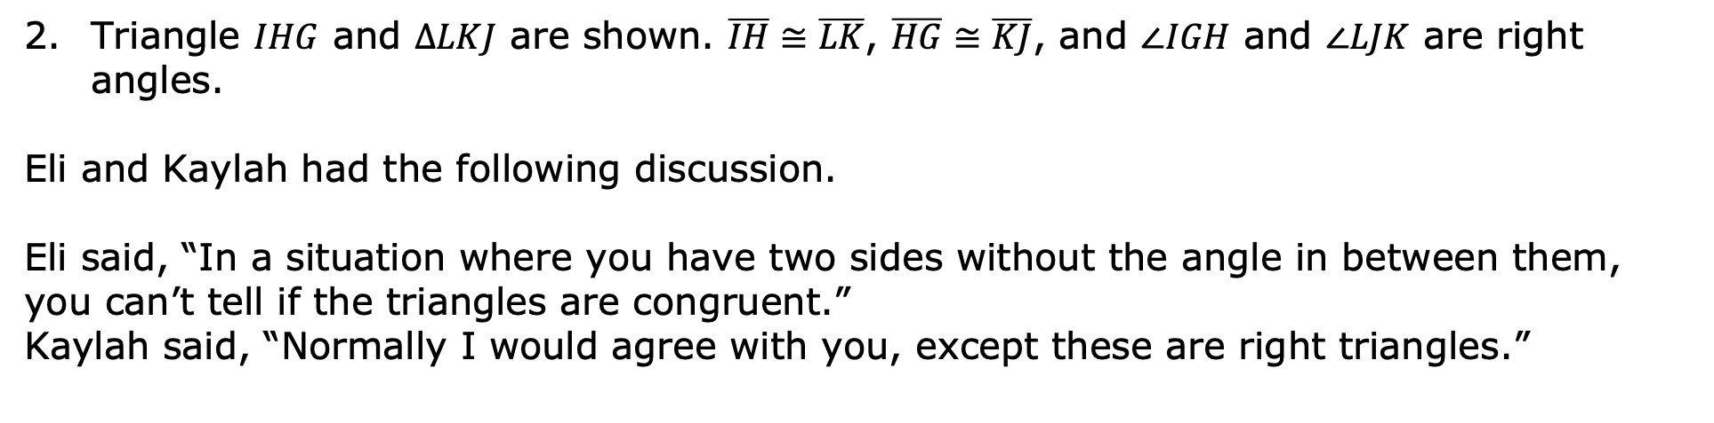
Triangle $IHG$ and $∆LKJ$ are shown. $\overline{IH}≅\overline{LK}$, $\overline{HG}≅\overline{KJ}$, and $∠IGH$ and $∠LJK$ are right angles.
Eli and Kaylah had the following discussion.
Eli said, “In a situation where you have two sides without the angle in between them, you can’t tell if the triangles are congruent.”
Kaylah said, “Normally I would agree with you, except these are right triangles.”
Discuss with your partner what Kaylah might be thinking.
When given two sides of a right triangle, how can the length of the third side be determined?
volume 1, pg. 238

Slide 19
Kaylah continued, “For a right triangle, as long as I have two of the sides, I can find the length of the third side. Then I can use SSS since all three corresponding sides would be congruent.”
Work with your partner to explain why Kaylah’s argument could work to show congruence for any pair of right triangles where the hypotenuse and one leg are identified as congruent.
Explain whether Kaylah’s argument would be needed to show congruence between right triangles where both legs of the triangles are identified as congruent.
volume 1, pg. 238

Slide 20

Bring It Together
volume 1, pg. 239

Slide 21


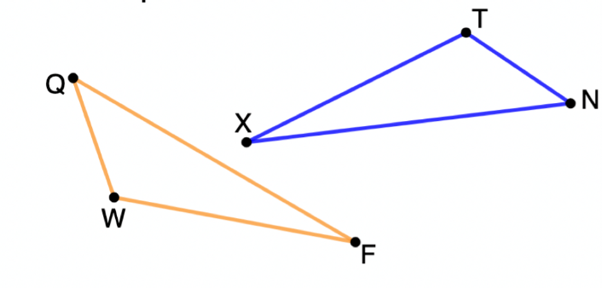
5.3.4 Bring It Together: Triangle Congruence
Angle-Angle-Side (AAS) Congruence Theorem
If two angles and a side opposite one of them are congruent to two angles and the corresponding side of the other, respectively, then the triangles are congruent.
Work with your partner to explain how Angle-Angle-Side Congruence Theorem is true. Use the triangles shown to provide an example if desired.
volume 1, pg. 239

Slide 22
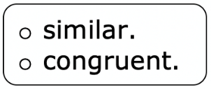

Complete the statements.
If two angles of one triangle are congruent to two angles of another triangle, then the third pair of angles
Are If a congruent side opposite one of the
given angles is congruent to the corresponding side of the other triangle, then also applies. Thus, AAS is
enough to show congruence.
volume 1, pg. 239

Slide 23
The Hypotenuse-Leg (HL) Theorem
Two right triangles are congruent if the hypotenuse and a leg of one are congruent to the hypotenuse and a leg of the other, respectively.
The previous lesson’s exploration showed that SSA is not sufficient to prove congruence. Explain why HL is sufficient to prove congruence for right triangles, despite being two sides with a non-included angle.
volume 1, pg. 239

Slide 24

Try It
volume 1, pg. 240

Slide 25

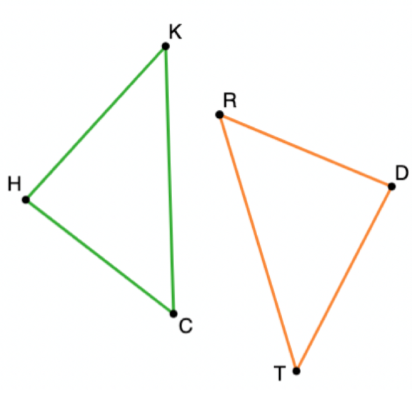
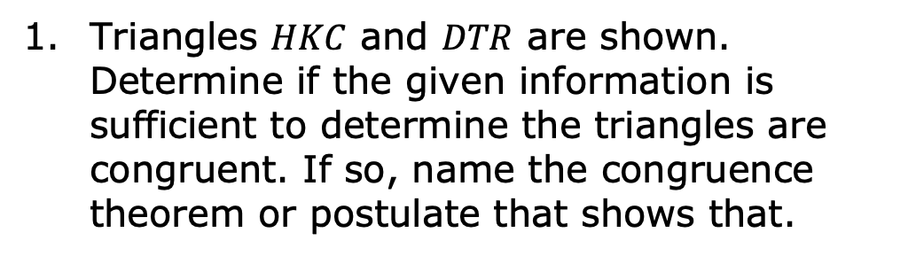
5.3.5 Try It: Which Criteria?
Triangles $HKC$ and $DTR$ are shown. Determine if the given information is sufficient to determine the triangles are congruent. If so, name the congruence theorem or postulate that shows that.
volume 1, pg. 240

Slide 26
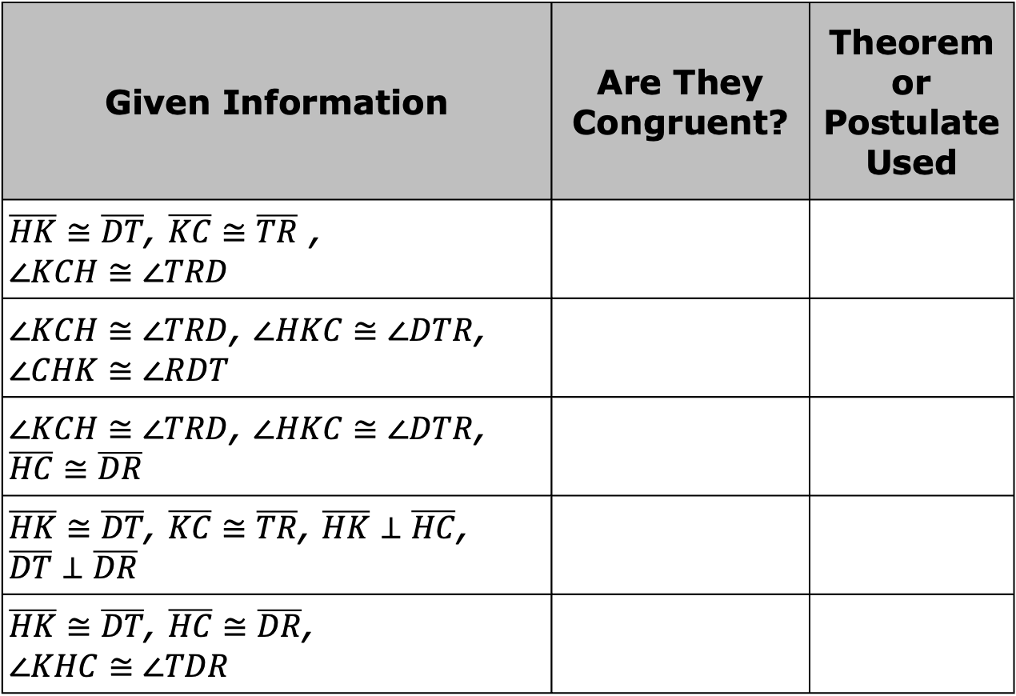
Given Information | Are They Congruent? | Theorem or Postulate Used
$\overline{HK}≅\overline{DT}$, $\overline{KC}≅\overline{TR}$ , $$∠KCH≅∠TRD$$
$∠KCH≅∠TRD$, $∠HKC≅∠DTR$, $∠CHK≅∠RDT$
$∠KCH≅∠TRD$, $∠HKC≅∠DTR$, $\overline{HC}≅\overline{DR}$
$\overline{HK}≅\overline{DT}$, $\overline{KC}≅\overline{TR}$, $\overline{HK}⊥\overline{HC}$, $\overline{DT}⊥\overline{DR}$
$\overline{HK}≅\overline{DT}$, $\overline{HC}≅\overline{DR}$, $$∠KHC≅∠TDR$$
volume 1, pg. 240

Slide 27

Wrap-Up
volume 1, pg. 240

Slide 28
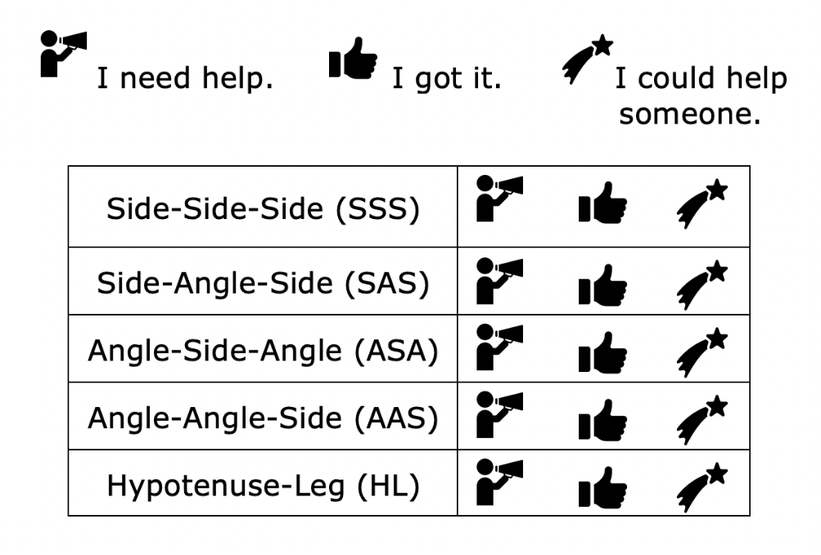
5.3.6 Wrap-Up: Reflection
Circle the icon that best describes your understanding of each congruence postulate or theorem.
volume 1, pg. 240

